Slide 2
World Handicap System
Notes:
So, the World Handicap System (or WHS) was launched in January of this year (2020) and to date over 35 countries are using the system, including most of the Americas, Australia, South Africa, Sweden and Finland.
Feedback received from these countries by the R&A has been very positive. Yes there have issues, the main one being the use of Technology, so it’s absolutely imperative that both we and the clubs get this right, and Sandy will look at this aspect a bit later.
The system will go into effect in all other parts of the world between now and sometime in 2021.
Here in Great Britain & Ireland we will do so on the 2nd of November 2020.

Slide 3
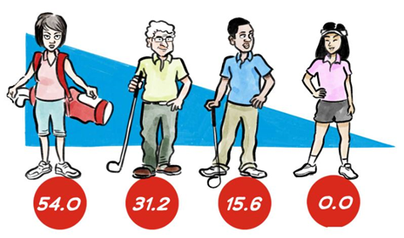
Seminar Content
WHS Overview
Rules of Handicapping
Principles of course rating
Establishing, Developing and maintaining a Handicap Index
Safeguards
Technology
Transition
Notes:
In this first session we’re going to give you an Overview of the System and we’re going to look at some of the Key Elements of the Rules.
Sandy will later go through the Handicap Committee procedures and the way in which Technology will underpin the system.

Slide 4
Purpose of the World Handicap System (Rule 1.1)
The World Handicap System includes the Rules of Handicapping and the Course Rating System.
Its purpose is to enable as many golfers as possible the opportunity to:
Obtain and maintain a Handicap Index.
Use their Handicap Index on any golf course around the world.
Compete, or play recreationally, with anyone else on a fair and equal basis.
Notes:
The Rules now include the USGA Course Rating System, something that we in Wales have been using for many many years. This system will become a fundamental part of enabling golfers to:
obtain and maintain a Handicap Index
Use that Index on any golf course around the world, and…..
Compete or play with anyone else on a fair and equal basis.
How will it do this?
Well, by:-
having a Course and Slope Rating for each set of tees
by, applying adjustments to players’ handicap indicies to reflect the level of difficulty of the course being played, and also the format used.
by, assessing the impact of Playing Conditions
by, limiting maximum hole scores,
by, applying uniform calculations for updating handicaps, and by updating these on a daily basis, and finally
by, reviewing players’ Handicap Indicies on a regular basis.

Slide 5
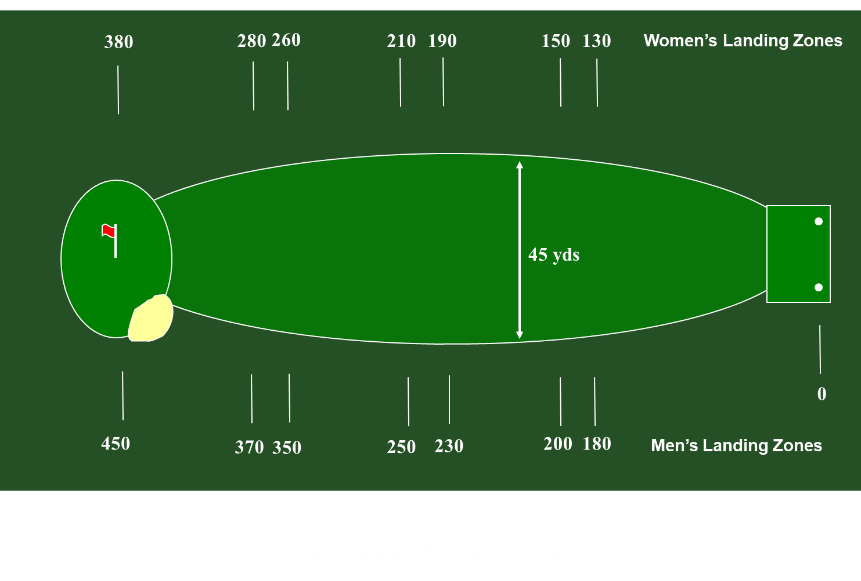
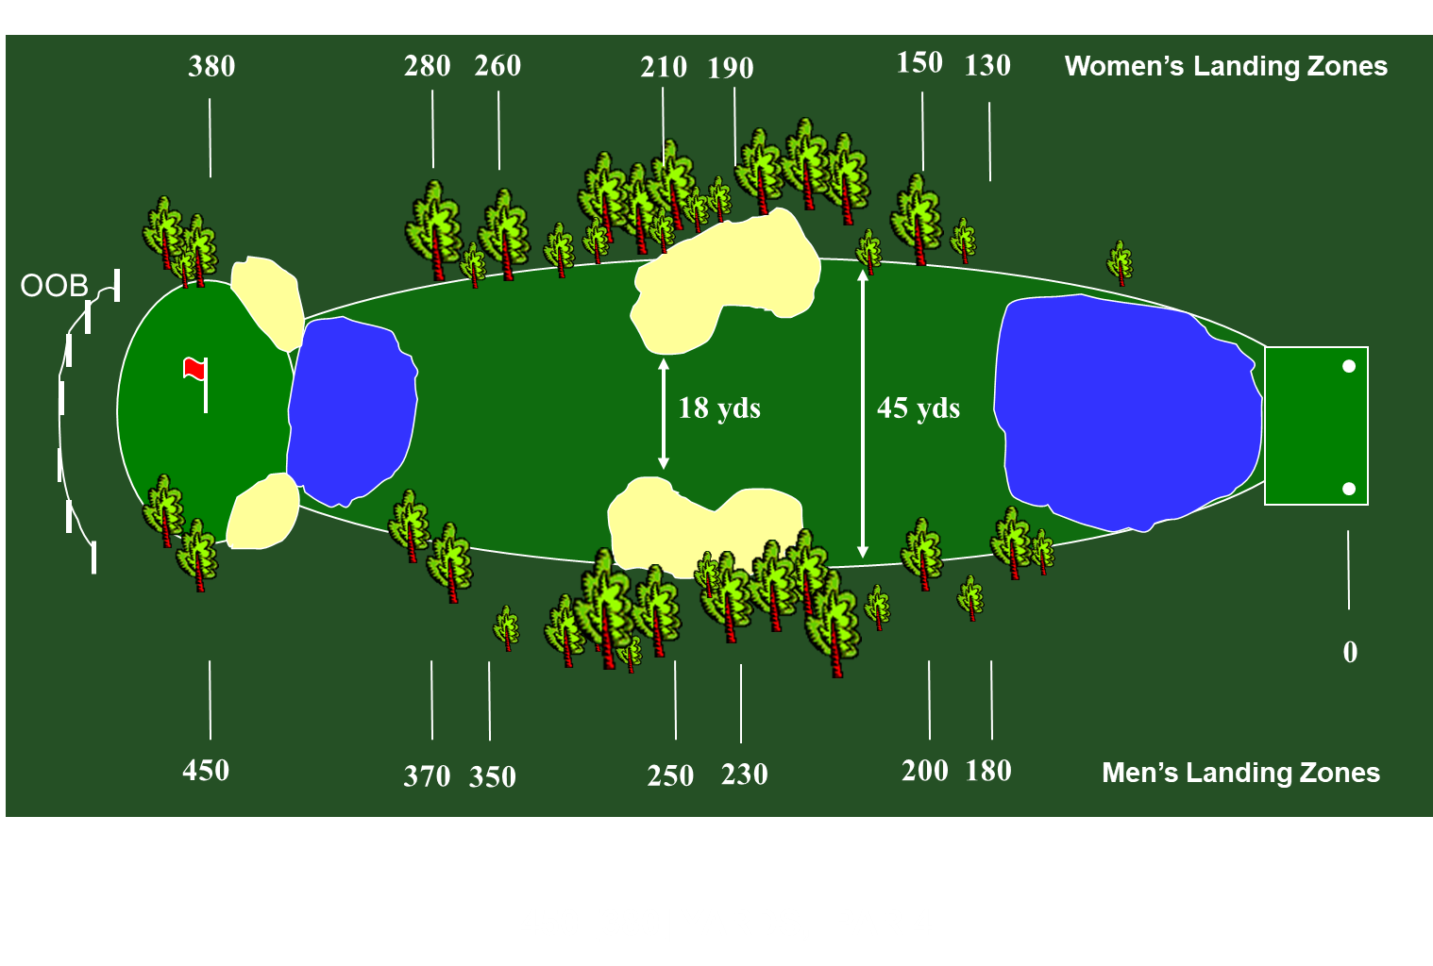
What is Course Rating?
Course Rating assesses the playing difficulty of all the golf courses in Wales.
This is done by a trained team of course raters, who will visit and assess you golf course. In Wales we aim to visit your golf course once every 10 years to make sure the figures a still accurate.
We assess the difficulty of the course for a scratch golfer and a bogey golfer.
The comparison between these two is what gives us your slope rating.
Notes:
Take this slide - both identical holes in terms of shape and length.
the top example has virtually no obstacles along its length, whereas in the lower example we’ve added water, which has to be crossed to both reach the fairway and the green, there are substantial bunkers at some of the Landing Zones and greenside, there are trees along both sides of the fairway, and there’s an OOB at the back of the green.
The lower hole is significantly more difficult to play, especially for the Bogey player, so the Rating will be higher.
So handicap indicies will be adjusted relative to the difficulty of the course being played.
This is one of the basis on which the WHS is built

Slide 6
What is Assessed When Rating a Golf Course?
Length | Obstacles (Difficulty Factors)
Measured Length Of Hole | Topography | Penalty Areas – Lateral
Roll | Fairway | Penalty Areas – Crossing
Elevation | Green Target | Trees
Doglegs/Forced Lay-ups | Recoverability from Rough | Green Surface
Wind | Bunkers | (Psychological)
Altitude
Notes:
Approximately 95% of the Rating is based on Length. and that figure includes:
the Measured Length of each hole - as shown on the Certificate of Measurements (which is why we ask for these before rating your courses)
the Roll on the ball, which, on average, will be around 20 yards
Elevation, which can either give you less or more Roll
whether the hole is a Dogleg or a Lay-up, which could lengthen the effective length of the hole
Wind - we would normal get average wind speeds form the Met Office, and finally……
Altitude - shot lengths on courses which have an altitude greater than 2,000 ft will be adjusted because shots would travel further in the thin air.
….then we have 10 Obstacles which we have to consider. So, we have….
the Topography - where we evaluate the impact of the train on play
Fairways - how difficult is it to keep the ball on them?
Green Target - how difficult is it to hit the green with your approach shot?
Recoverability from the Rough - how difficult is it to recover if you miss the fairway or green?
Bunkers - same again, how difficult is it to recover from them? where are they, how deep and so forth
Penalty Areas - both Lateral and Crossing - what length of shot is needed to ‘safely carry’ a penalty area? what’s the distance of a Lateral obstruction from the centre of a Landing Zone?
Trees - what’s the overall impact of trees on the play of a hole?
Green Surfaces - how fast are they? are they flat or contoured? and finally…….
Psychological - where we evaluate the cumulative effect of all the above obstacles on a player’s score

Slide 7
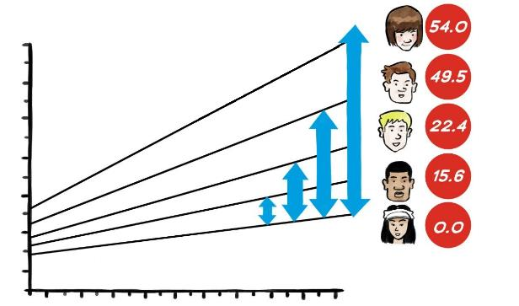
What is a Slope Rating?
A Slope Rating is the number which indicates the relative playing difficulty of a course for bogey golfers, compared to scratch golfers.
It is the combination of the Course Rating and the Bogey rating that allow us to calculate the Slope Rating of a set of tees.
Notes:
Well, Slope is the relative playing difficulty of a course for a Bogey golfer compared to that of for a Scratch golfer.
That difference in the two rating figures is then multiplied by a fixed number (which is different for Men and Ladies) to arrive at the Slope Rating.
and Slope Ratings range from 55 to 155 - with 155 showing the most relative difficulty.
The standard Slope Rating used throughout the System is 113, and you’ll find this figure cropping up in various algorithms, for example, when working out Gross Differentials.
The average Slope Rating throughout GB&I is around 124, but please don’t get hung up with your club’s Slope Rating compared to those of other clubs - Slope is not a direct comparison between one club and another. As I’ve just said, it’s the comparison between the scratch and bogey golfer on each set of tees.

Slide 8
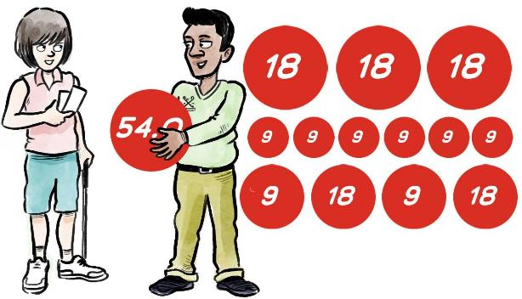
How to get a Handicap Index
If you already hold a handicap?
The current scores on your handicap record will automatically be converted into a WHS handicap.
If you don’t currently have a handicap?
54 holes made up of any combination of 9- or 18-hole rounds.
No time limit on completing the submission of these scores.
Your handicap index will continue to develop until it contains 20 scores.
Notes:
The simple answer to that? ‘in exactly the same way as they do now - by submitting scores for 54 holes, made up of any combination of 9 or 18 hole rounds.

Slide 9
Calculation of a Handicap Index
For Fewer Than 20 Scores
Number of score differentials in scoring record | Score differential(s) to be used in calculation of Handicap Index | Adjustment
3 | Lowest 1 | -2.0
4 | Lowest 1 | -1.0
5 | Lowest 1 | 0
6 | Average of lowest 2 | -1.0
7 or 8 | Average of lowest 2 | 0
9 to 11 | Average of lowest 3 | 0
12 to 14 | Average of lowest 4 | 0
15 or 16 | Average of lowest 5 | 0
17 or 18 | Average of lowest 6 | 0
19 | Average of lowest 7 | 0
20 | Average of lowest 8 | 0
Notes:
This table shows the sequence used.
So, from 3 to 5 scores, we take the lowest score differential, and adjust that depending on the number of scores submitted, so 2 less than the lowest differential after 3 scores to no adjustment when we get to 5 scores.
Thereafter we start to average a set of the lowest differentials, starting from the average of the lowest 2 with 6 scores to the average of the lowest 8 when the player has a fully developed record of 20 scores.
Only scores from players with a fully developed handicap will be used in the Playing Conditions Calculations.

Slide 10
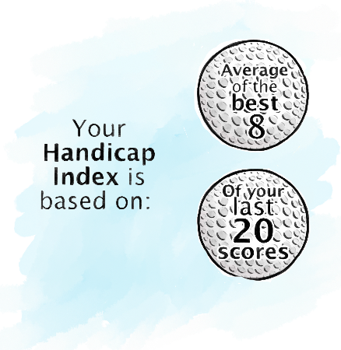
Calculation of a Handicap Index
For 20 Scores
Average the lowest 8 of the most recent 20 score differentials, rounded to the nearest tenth.
Remembers previously demonstrated ability within a defined period of time.
Caps the upward movement of a handicap index within a defined period of time.
Applies additional adjustments to Index when an exceptional score is submitted. (ESR)
Notes:
- So how do we CALCULATE HANDICAP INDICIES once a player has this fully developed handicap?
We know that we average the lowest 8 of the most recent 20 score differentials, rounded to nearest tenth - so to one decimal point.
The system also has an inbuilt memory of all scores within the past 12 months, and uses this to ‘cap’ a handicap to stop it rising too quickly because of a short run of poor form.
It also applies reductions for exceptional scores, which happens now of course, and these will be done automatically, but the Handicap Committee can override these reduction if it’s appropriate to do so.

Slide 11
Example of a Scoring Record
Score No. | Date Played | Course | Course Rating | Slope Rating | Adjusted Gross Score | Score Differential
1 | 22/9/20 | Hill GC | 70.5 | 125 | 91 | 18.5
2 | 5/9/20 | Hill GC | 70.5 | 125 | 92 | 19.4
3 | 1/9/20 | Hill GC | 70.5 | 125 | 99 | 25.8
4 | 28/8/20 | Hill GC | 70.5 | 125 | 89 | 16.7
5 | 23/8/20 | River GC | 71.3 | 127 | 92 | 18.4
6 | 26/7/20 | Meadow GC | 72.2 | 131 | 87 | 12.8
7 | 14/7/20 | Hill GC | 70.5 | 125 | 97 | 24.0
8 | 4/7/20 | Hill GC | 70.5 | 125 | 88 | 15.8
9 | 19/6/20 | River GC | 71.3 | 127 | 87 | 13.5
10 | 16/6/20 | Valley GC | 69.9 | 118 | 95 | 24.0
11 | 12/6/20 | Forest GC | 70.1 | 115 | 86 | 15.6
12 | 5/6/20 | Meadow GC | 72.2 | 131 | 85 | 11.0
13 | 2/6/20 | Hill GC | 70.5 | 125 | 82 | 10.4
14 | 30/5/20 | Hill GC | 70.5 | 125 | 94 | 21.2
15 | 25/5/20 | Valley GC | 69.9 | 118 | 89 | 18.3
16 | 22/5/20 | Hill GC | 70.5 | 125 | 97 | 24.0
17 | 29/4/20 | Hill GC | 70.5 | 125 | 85 | 13.1
18 | 14/4/20 | Hill GC | 70.5 | 125 | 93 | 20.3
19 | 10/4/20 | Hill GC | 70.5 | 125 | 94 | 21.2
20 | 3/4/20 | Meadow GC | 72.2 | 131 | 86 | 12.1
21
Notes:
This player has 20 scores on his or her record, so we simply take the lowest 8 (seen in the right hand column) and average that figure.

Slide 12
Example of 8 of 20 Calculation
Score No. | Date Played | Course | Course Rating | Slope Rating | Adjusted Gross Score | Score Differential
1 | 22/9/20 | Hill GC | 70.5 | 125 | 91 | 18.5
2 | 5/9/20 | Hill GC | 70.5 | 125 | 92 | 19.4
3 | 1/9/20 | Hill GC | 70.5 | 125 | 99 | 25.8
4 | 28/8/20 | Hill GC | 70.5 | 125 | 89 | 16.7
5 | 23/8/20 | River GC | 71.3 | 127 | 92 | 18.4
6 | 26/7/20 | Meadow GC | 72.2 | 131 | 87 | 12.8
7 | 14/7/20 | Hill GC | 70.5 | 125 | 97 | 24.0
8 | 4/7/20 | Hill GC | 70.5 | 125 | 88 | 15.8
9 | 19/6/20 | River GC | 71.3 | 127 | 87 | 13.5
10 | 16/6/20 | Valley GC | 69.9 | 118 | 95 | 24.0
11 | 12/6/20 | Forest GC | 70.1 | 115 | 86 | 15.6
12 | 5/6/20 | Meadow GC | 72.2 | 131 | 85 | 11.0
13 | 2/6/20 | Hill GC | 70.5 | 125 | 82 | 10.4
14 | 30/5/20 | Hill GC | 70.5 | 125 | 94 | 21.2
15 | 25/5/20 | Valley GC | 69.9 | 118 | 89 | 18.3
16 | 22/5/20 | Hill GC | 70.5 | 125 | 97 | 24.0
17 | 29/4/20 | Hill GC | 70.5 | 125 | 85 | 13.1
18 | 14/4/20 | Hill GC | 70.5 | 125 | 93 | 20.3
19 | 10/4/20 | Hill GC | 70.5 | 125 | 94 | 21.2
20 | 3/4/20 | Meadow GC | 72.2 | 131 | 86 | 12.1
21
Notes:
These are the lowest 8 score differentials highlighted in yellow.

Slide 13
Example of 8 of 20 Calculation
Score No. | Date Played | Course | Course Rating | Slope Rating | Adjusted Gross Score | Score Differential
1 | 22/9/20 | Hill GC | 70.5 | 125 | 91 | 18.5
2 | 5/9/20 | Hill GC | 70.5 | 125 | 92 | 19.4
3 | 1/9/20 | Hill GC | 70.5 | 125 | 99 | 25.8
4 | 28/8/20 | Hill GC | 70.5 | 125 | 89 | 16.7
5 | 23/8/20 | River GC | 71.3 | 127 | 92 | 18.4
6 | 26/7/20 | Meadow GC | 72.2 | 131 | 87 | 12.8
7 | 14/7/20 | Hill GC | 70.5 | 125 | 97 | 24.0
8 | 4/7/20 | Hill GC | 70.5 | 125 | 88 | 15.8
9 | 19/6/20 | River GC | 71.3 | 127 | 87 | 13.5
10 | 16/6/20 | Valley GC | 69.9 | 118 | 95 | 24.0
11 | 12/6/20 | Forest GC | 70.1 | 115 | 86 | 15.6
12 | 5/6/20 | Meadow GC | 72.2 | 131 | 85 | 11.0
13 | 2/6/20 | Hill GC | 70.5 | 125 | 82 | 10.4
14 | 30/5/20 | Hill GC | 70.5 | 125 | 94 | 21.2
15 | 25/5/20 | Valley GC | 69.9 | 118 | 89 | 18.3
16 | 22/5/20 | Hill GC | 70.5 | 125 | 97 | 24.0
17 | 29/4/20 | Hill GC | 70.5 | 125 | 85 | 13.1
18 | 14/4/20 | Hill GC | 70.5 | 125 | 93 | 20.3
19 | 10/4/20 | Hill GC | 70.5 | 125 | 94 | 21.2
20 | 3/4/20 | Meadow GC | 72.2 | 131 | 86 | 12.1
21
 | 12.8
+ | 15.8
+ | 13.5
+ | 15.6
+ | 11.0
+ | 10.4
+ | 13.1
+ | 12.1
= | 104.3 | / | 8
Adding together the best 8 differentials out of the last 20:
And averaging the total:
Handicap Index of 13.0
Notes:
..and the average of those works out at 13.0

Slide 14
Example of 8 of 20 Calculation
Score No. | Date Played | Course | Course Rating | Slope Rating | Adjusted Gross Score | Score Differential
1 | 22/9/20 | Hill GC | 70.5 | 125 | 91 | 18.5
2 | 5/9/20 | Hill GC | 70.5 | 125 | 92 | 19.4
3 | 1/9/20 | Hill GC | 70.5 | 125 | 99 | 25.8
4 | 28/8/20 | Hill GC | 70.5 | 125 | 89 | 16.7
5 | 23/8/20 | River GC | 71.3 | 127 | 92 | 18.4
6 | 26/7/20 | Meadow GC | 72.2 | 131 | 87 | 12.8
7 | 14/7/20 | Hill GC | 70.5 | 125 | 97 | 24.0
8 | 4/7/20 | Hill GC | 70.5 | 125 | 88 | 15.8
9 | 19/6/20 | River GC | 71.3 | 127 | 87 | 13.5
10 | 16/6/20 | Valley GC | 69.9 | 118 | 95 | 24.0
11 | 12/6/20 | Forest GC | 70.1 | 115 | 86 | 15.6
12 | 5/6/20 | Meadow GC | 72.2 | 131 | 85 | 11.0
13 | 2/6/20 | Hill GC | 70.5 | 125 | 82 | 10.4
14 | 30/5/20 | Hill GC | 70.5 | 125 | 94 | 21.2
15 | 25/5/20 | Valley GC | 69.9 | 118 | 89 | 18.3
16 | 22/5/20 | Hill GC | 70.5 | 125 | 97 | 24.0
17 | 29/4/20 | Hill GC | 70.5 | 125 | 85 | 13.1
18 | 14/4/20 | Hill GC | 70.5 | 125 | 93 | 20.3
19 | 10/4/20 | Hill GC | 70.5 | 125 | 94 | 21.2
20 | 3/4/20 | Meadow GC | 72.2 | 131 | 86 | 12.1
21
Score No. | Date Played | Course | Course Rating | Slope Rating | Adjusted Gross Score | Score Differential
2 | 22/9/20 | Hill GC | 70.5 | 125 | 91 | 18.5
3 | 5/9/20 | Hill GC | 70.5 | 125 | 92 | 19.4
4 | 1/9/20 | Hill GC | 70.5 | 125 | 99 | 25.8
5 | 28/8/20 | Hill GC | 70.5 | 125 | 89 | 16.7
6 | 23/8/20 | River GC | 71.3 | 127 | 92 | 18.4
7 | 26/7/20 | Meadow GC | 72.2 | 131 | 87 | 12.8
8 | 14/7/20 | Hill GC | 70.5 | 125 | 97 | 24.0
9 | 4/7/20 | Hill GC | 70.5 | 125 | 88 | 15.8
10 | 19/6/20 | River GC | 71.3 | 127 | 87 | 13.5
11 | 16/6/20 | Valley GC | 69.9 | 118 | 95 | 24.0
12 | 12/6/20 | Forest GC | 70.1 | 115 | 86 | 15.6
13 | 5/6/20 | Meadow GC | 72.2 | 131 | 85 | 11.0
14 | 2/6/20 | Hill GC | 70.5 | 125 | 82 | 10.4
15 | 30/5/20 | Hill GC | 70.5 | 125 | 94 | 21.2
16 | 25/5/20 | Valley GC | 69.9 | 118 | 89 | 18.3
17 | 22/5/20 | Hill GC | 70.5 | 125 | 97 | 24.0
18 | 29/4/20 | Hill GC | 70.5 | 125 | 85 | 13.1
19 | 14/4/20 | Hill GC | 70.5 | 125 | 93 | 20.3
20 | 10/4/20 | Hill GC | 70.5 | 125 | 94 | 21.2
21 | 3/4/20 | Meadow GC | 72.2 | 131 | 86 | 12.1
1 | 25/9/20 | Meadow GC | 72.2 | 131 | 89 | 14.5
Notes:
… a further round is then played on the 25th of September at Meadow Golf Club, this time with a score differential of 14.5

Slide 15
Example of 8 of 20 Calculation
Score No. | Date Played | Course | Course Rating | Slope Rating | Adjusted Gross Score | Score Differential
1 | 22/9/20 | Hill GC | 70.5 | 125 | 91 | 18.5
2 | 5/9/20 | Hill GC | 70.5 | 125 | 92 | 19.4
3 | 1/9/20 | Hill GC | 70.5 | 125 | 99 | 25.8
4 | 28/8/20 | Hill GC | 70.5 | 125 | 89 | 16.7
5 | 23/8/20 | River GC | 71.3 | 127 | 92 | 18.4
6 | 26/7/20 | Meadow GC | 72.2 | 131 | 87 | 12.8
7 | 14/7/20 | Hill GC | 70.5 | 125 | 97 | 24.0
8 | 4/7/20 | Hill GC | 70.5 | 125 | 88 | 15.8
9 | 19/6/20 | River GC | 71.3 | 127 | 87 | 13.5
10 | 16/6/20 | Valley GC | 69.9 | 118 | 95 | 24.0
11 | 12/6/20 | Forest GC | 70.1 | 115 | 86 | 15.6
12 | 5/6/20 | Meadow GC | 72.2 | 131 | 85 | 11.0
13 | 2/6/20 | Hill GC | 70.5 | 125 | 82 | 10.4
14 | 30/5/20 | Hill GC | 70.5 | 125 | 94 | 21.2
15 | 25/5/20 | Valley GC | 69.9 | 118 | 89 | 18.3
16 | 22/5/20 | Hill GC | 70.5 | 125 | 97 | 24.0
17 | 29/4/20 | Hill GC | 70.5 | 125 | 85 | 13.1
18 | 14/4/20 | Hill GC | 70.5 | 125 | 93 | 20.3
19 | 10/4/20 | Hill GC | 70.5 | 125 | 94 | 21.2
20 | 3/4/20 | Meadow GC | 72.2 | 131 | 86 | 12.1
21
Score No. | Date Played | Course | Course Rating | Slope Rating | Adjusted Gross Score | Score Differential
1 | 25/9/20 | Meadow GC | 72.2 | 131 | 89 | 14.5
2 | 22/9/20 | Hill GC | 70.5 | 125 | 91 | 18.5
3 | 5/9/20 | Hill GC | 70.5 | 125 | 92 | 19.4
4 | 1/9/20 | Hill GC | 70.5 | 125 | 99 | 25.8
5 | 28/8/20 | Hill GC | 70.5 | 125 | 89 | 16.7
6 | 23/8/20 | River GC | 71.3 | 127 | 92 | 18.4
7 | 26/7/20 | Meadow GC | 72.2 | 131 | 87 | 12.8
8 | 14/7/20 | Hill GC | 70.5 | 125 | 97 | 24.0
9 | 4/7/20 | Hill GC | 70.5 | 125 | 88 | 15.8
10 | 19/6/20 | River GC | 71.3 | 127 | 87 | 13.5
11 | 16/6/20 | Valley GC | 69.9 | 118 | 95 | 24.0
12 | 12/6/20 | Forest GC | 70.1 | 115 | 86 | 15.6
13 | 5/6/20 | Meadow GC | 72.2 | 131 | 85 | 11.0
14 | 2/6/20 | Hill GC | 70.5 | 125 | 82 | 10.4
15 | 30/5/20 | Hill GC | 70.5 | 125 | 94 | 21.2
16 | 25/5/20 | Valley GC | 69.9 | 118 | 89 | 18.3
17 | 22/5/20 | Hill GC | 70.5 | 125 | 97 | 24.0
18 | 29/4/20 | Hill GC | 70.5 | 125 | 85 | 13.1
19 | 14/4/20 | Hill GC | 70.5 | 125 | 93 | 20.3
20 | 10/4/20 | Hill GC | 70.5 | 125 | 94 | 21.2
21 | 3/4/20 | Meadow GC | 72.2 | 131 | 86 | 12.1
1 | 25/9/20 | Meadow GC | 72.2 | 131 | 89 | 14.5
Notes:
….so the round played at Meadow GC on the 3rd of April (with a score differential of 12.1) now drops out of the last 20 scores

Slide 16
Example of 8 of 20 Calculation
Score No. | Date Played | Course | Course Rating | Slope Rating | Adjusted Gross Score | Score Differential
1 | 25/9/20 | Meadow GC | 72.2 | 131 | 89 | 14.5
2 | 22/9/20 | Hill GC | 70.5 | 125 | 91 | 18.5
3 | 5/9/20 | Hill GC | 70.5 | 125 | 92 | 19.4
4 | 1/9/20 | Hill GC | 70.5 | 125 | 99 | 25.8
5 | 28/8/20 | Hill GC | 70.5 | 125 | 89 | 16.7
6 | 23/8/20 | River GC | 71.3 | 127 | 92 | 18.4
7 | 26/7/20 | Meadow GC | 72.2 | 131 | 87 | 12.8
8 | 14/7/20 | Hill GC | 70.5 | 125 | 97 | 24.0
9 | 4/7/20 | Hill GC | 70.5 | 125 | 88 | 15.8
10 | 19/6/20 | River GC | 71.3 | 127 | 87 | 13.5
11 | 16/6/20 | Valley GC | 69.9 | 118 | 95 | 24.0
12 | 12/6/20 | Forest GC | 70.1 | 115 | 86 | 15.6
13 | 5/6/20 | Meadow GC | 72.2 | 131 | 85 | 11.0
14 | 2/6/20 | Hill GC | 70.5 | 125 | 82 | 10.4
15 | 30/5/20 | Hill GC | 70.5 | 125 | 94 | 21.2
16 | 25/5/20 | Valley GC | 69.9 | 118 | 89 | 18.3
17 | 22/5/20 | Hill GC | 70.5 | 125 | 97 | 24.0
18 | 29/4/20 | Hill GC | 70.5 | 125 | 85 | 13.1
19 | 14/4/20 | Hill GC | 70.5 | 125 | 93 | 20.3
20 | 10/4/20 | Hill GC | 70.5 | 125 | 94 | 21.2
21 | 3/4/20 | Meadow GC | 72.2 | 131 | 86 | 12.1
 | 14.5
+ | 12.8
+ | 15.8
+ | 13.5
+ | 15.6
+ | 11.0
+ | 10.4
+ | 13.1
= | 106.7 | ÷ | 8
Adding together the best 8 differentials out of the last 20:
And averaging the total:
Handicap Index of 13.3
Notes:
…and we go through the same process again of averaging the lowest 8 using a new set of 20 scores. This time the new Handicap Index is 13.3. So you can see that handicaps under WHS can increase far quicker than under the current CONGU system.
To calculate the score differential under WHS you’ll need your adjusted gross score minus the CR of the tees played x the standard slope rating of 113 divided by the SR of the tees played. So not an easy task and again an aspect of the system where technology will play a critical role.

Slide 17
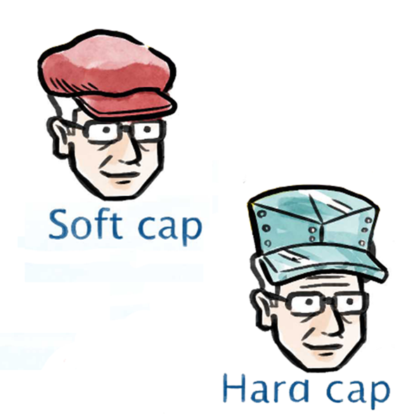
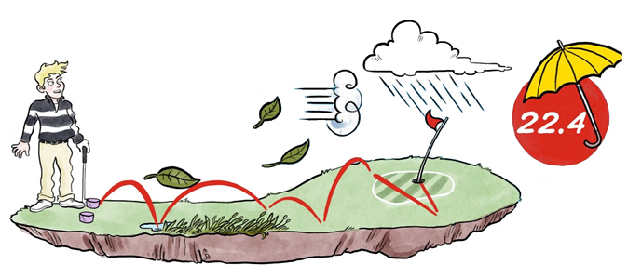
System Safeguards
To improve the accuracy and to safeguard against manipulation there are safeguards built into the new system.
Low Handicap Index memory.
Caps.
Exceptional Scores.
Playing Conditions Calculation.

Slide 18
Memory of Low Handicap Index
Low
Handicap
Index
A player’s Low Handicap Index is remembered within the handicap formula.
It provides a reference point against which the current Handicap Index can be compared.
This is to help ensure that the player’s current Handicap Index cannot stray too far away from their demonstrated ability, in too short a space of time.
If the new Index is more than a certain number of strokes above the Low Handicap Index, a cap is triggered.
Notes:
We limit handicap increases by using the System’s inbuilt memory, which remembers a player’s Low Handicap Index, and it uses this ‘memory’ to ensure that the Handicap Index doesn’t stray too much from the level of ability that the player has already shown to have.
It does this by applying a ‘cap’ when the new Index begins to increase more than a certain number of strokes above Low Index.
The Cap is a safeguard within the WHS to manage such situations.

Slide 19
Limit on Upward Movement of Handicap Index
The cap comes in two forms:
The soft cap suppresses upward movement
The hard cap prevents further upward movement
Notes:
…… and the ‘cap’ comes in two forms - a soft cap and a hard cap.
So the soft cap will start slowing down how quickly your handicap increases if necessary, and the hard cap will add an absolute stop.
The soft cap begins to kick in if you handicap increased by more that 3 from your low index and will basically decrease the speed of upward movement of the handicap by half. The hard cap will stop things all together once the handicap increases by 5 or more.

Slide 20
Exceptional Scores
A Score Differential which is at least 7.0 strokes or more better than the player’s Handicap Index at the time the round was played.
Score can be from any format of play, competitive or general play.
When a player submits an exceptional score, the handicap formula applies an additional adjustment to the player’s updated Handicap Index – according to the table.
This adjustment is in addition to any reduction caused within the 8/20 calculation.
The Handicap Committee can override the adjustment.
Score Differential Relative to Index | -7.0 | -10.0
Extra adjustment | -1.0 | -2.0
Notes:
There are no caps for downward movements.
A score of 7 or more strokes better than a player’s Handicap Index will result in an automatic reduction of 1 extra shot. A score of 10 or more strokes better will result in a reduction of 2 extra shots.
The Handicap Committee can override this adjustment, but only having considered all the evidence. If it then considers that the adjustment would result in the new HI not being a fair reflection of the player’s demonstrated ability it can reverse the reduction.

Slide 21
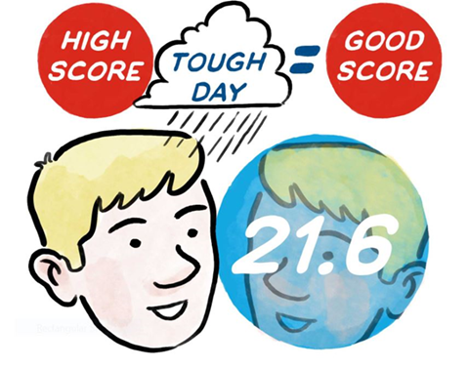
Playing Conditions Calculation
Abnormal playing conditions can be caused by weather and/or course set-up.
The PCC assesses whether playing conditions on the day were ‘normal’ or significantly harder or easier than normal.
Notes:
We’re all familiar with this adjustment under the current CONGU system (the CSS), and it’s pretty much the same under WHS.
The PCC is generally performed once a day, with all scores on that day taken into account.
When abnormal playing conditions cause scores to be higher or lower than expected on a given day, a Playing Conditions Calculation will adjust score differentials to better reflect the player’s actual performance.
So, a higher score on a tough day could end up as being one of your best 8.

Slide 22
Acceptability of Scores
Rounds played:
In an authorised format of play.
Over a minimum number of holes.
By the Rules of Golf.
With at least one other person.
On a course with a current Course Rating and Slope Rating.
Certified in accordance with Rules of Handicapping.
Notes:
So, Rule 2.1, these are the scores which are acceptable for handicap purposes:-
Rounds played in an authorized format.
Rounds played over a minimum number of holes - we’ll look at this in a bit more detail shortly
Rounds played by the Rules of Golf, and
with at least one other person - and generally someone who’s acceptable to your handicap committee.
on a course with current Course and Slope Ratings
The score has to be certified, or signed, by a marker and be made available for peer review
If one or more of these requirements are not met, the score is not acceptable for handicap purposes.
The score must be certified (see next slide)

Slide 23
Authorized Formats of Play (Rule 2.1a)
Format of Play | Type of Round | Number of Holes
Individual Stroke play | Organised Competition | 9 |  | 18
 | General play | 9 |  | 18
 | Stableford Organised Competition | 9 |  | 18
 | Stableford General play | 9 |  | 18
 | Par/Bogey Organised competition | 9 |  | 18
 | Par/Bogey General play | 9 |  | 18
 | Maximum Score Organised competition | 9 |  | 18
 | Maximum Score General play | 9 |  | 18
Notes:
These are the formats acceptable within GB & I.
For now, forget what you’ve heard about betterballs, matchplay and submitting a card every time you go out to play recreational golf.
Truth is that under WHS we will be using exactly the same formats as we do now, so that’s individual stroke play, whether organised or in general play, in other words medals, stablefords, par/bogey and maximum score rounds.
By general play we mean supplementary scores.
By organised competitions we mean those organised by the handicap committee, or regularly organised events such as Roll-Ups or Swindles, not necessarily organised by the club, in can be the Professional or a member, but all those playing will have agreed that their scores can be submitted for handicap purposes.

Slide 24
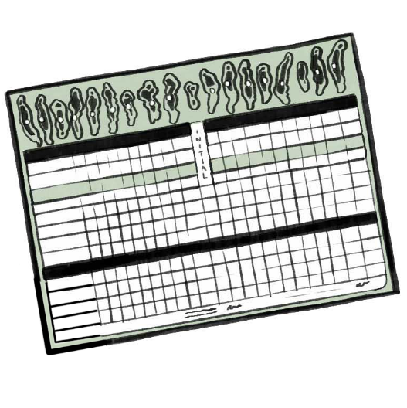
Minimum Number of Holes
If playing an 18 hole round and the player completes more than 9 holes, the score is added to the record.
If playing a 9 hole round all holes must be played:
If the minimum number of holes are not played the score is discarded and not included in the players record.
Notes:
This is Rule 2.2.
For an 18 hole score - a minimum of 10 holes must be played for the score to be acceptable.
For a 9 hole score all 9 holes must be played

Slide 25
Hole Scores May Be Adjusted
By Net Double Bogey for a high score
Or
If all holes haven’t been played, recording a Net Par on the holes not played.
Exception: If less than 14 holes of 18 hole round have been played, net par +1 stroke must be added to the first hole not played and net par to remaining un-played holes.
These adjustments are made using the course handicap and will be applied by the computer.
Notes:
As you do now, you adjust a high score by applying the Net Double Bogey rule - that’s the lowest score on a hole for the which a player would get ZERO stableford points.
However, if you’re playing an 18 hole round, and if all the holes haven’t been played, then you record a Net Par on those holes not played.
By ‘holes not played’ we mean those not started, we don’t mean holes started but not finished - these are dealt with under the NDB rule.
However, there is an exception - if you’ve played less than 14 holes of an 18 hole round (say you didn’t play the 12th and 13th) you record a net par + 1 on that first unplayed hole (the 12th), and the rest would be net pars.
However there must be a valid reason why holes have not been played - for instance:
bad light or bad weather
player injury or illness, or
a hole being declared out of play by the Committee for maintenance or reconstruction.
If the Committee consider the player’s reason for not completing the round as being invalid they can apply a penalty score under Rule 7.1.
These will all be handled within the system and should be made clear when entering the scores into the system at the end of play.
The key takeawy from this is that even if you do NR for whatever reason from a competition there is no reason to stop scoring on your scorecard. If you had a pretty good round going until you NR’d. You could then continue to enter scores and it may even end up as a card that forms part of your best 8 scores.

Slide 26
Pre-Registration/Supplementary Scores
The Idea of pre-registration/supplementary score will remain unchanged from current CONGU regulations.
Such pre-registration must be made:
Before the player starts the round, and
In the manner prescribed by the Handicap Committee.
You can be considered to have pre-registered their intent to submit a score if playing in a regular, organized event with other players.
Notes:
Supplementary Scores are now referred to as General Play, but the process of submitting scores is exactly the same as now.
and as I said earlier - a player can be considered to have pre-registered to submit a supplementary score by playing in a regular organised event with other players - but the organiser should make that perfectly clear to those who are playing.

Slide 27
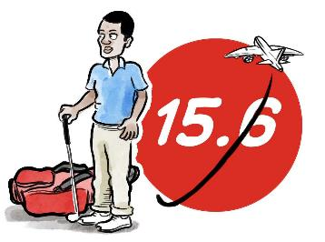
When to Submit Score
 | Format Authorized at Home | Format Unauthorized at Home
Round Played Away in Authorized Format | Submit score | Submit score
Round Played Away in Unauthorized Format | Submit score | Not acceptable
Notes:
This is where it gets a little confusing! Many people now play competitive golf abroad (although sadly not at present!)
Say you’re playing in Spain, and the competition is an individual stableford. That’s an acceptable format within both GB & I and Spain - so you must return your score to your home club - that’s fairly clear.
If you were playing in Spain in a fourball betterball, and say that was an acceptable score in Spain, but is clearly not over here, then you would also have to return your score to your home club. This is where the technology will be crucial in facilitating that.
If you were playing in Spain in say a par/bogey, which may not be an authorised format in Spain, but is within GB & I, then again you’d have to return your score to your home club.
and finally …… if the round you’re playing in Spain is unauthorised both there and within GB & I, say matchplay, then the score would not be acceptable for handicap purposes.

Slide 28
Certification of a Score
The options are:
Score must be certified by a marker prior to submission, and
Score must be available for peer review as soon as possible after being posted to the scoring record.
Notes:
As I said previously, all acceptable scores must be certified by a marker and be available for peer review as soon as possible after completing the round.
By ‘peer review’ we mean that the card can be further scrutinised by someone other than the marker who was playing in the same group, or, by someone who is a member of the same golf club.
So, a player playing in the same group can challenge the score if he thinks that there are any anomalies on the posted card, and…..
a Member of the club can reasonably verify or challenge the player’s Handicap Index if he has knowledge of that player’s demonstrated ability.
So in order to allow all of this, players' scoring records must be accessible to all other members of the golf club.
This is again a technology issue and is also covered in Appendix B of the Rules.

Slide 29
How do I get from car to course?
What do I need to do when I want to play?
Handicap Index.
Course Handicap
Simply select the tees you want to play and look up your handicap index to ascertain your course handicap.
Play Golf.
Enter Score.
Notes:
If we move on now to the nitty gritty of actually playing golf under the new system, which after what we have just seen may seem a little daunting. However it is really quite simple. All you need to remember of 4 things.
Handicap Index. Know what it is and where to find it.
Course handicap. This is the big change, but won’t be completely alien to those who play a lot of golf abroad. You need to know what this is, how to work it out, or where to find it and we will move on to that shortly.
If you are playing in a comp you will also need to know what your handicap allowance is. For the format you are playing and we will also touch on that
Play golf. We should all understand that even though most of us still struggle to do it well
Enter your score. If you are playing in qualifying round of course you must enter your score.

Slide 30
Handicap Conversion Chart
For all rated courses at the club
Notes:
In order to play golf you must convert your handicap index into a couse handicap which may be different for each set of tees at your club and will be different.
Most golf clubs will be placing handicap conversion tables at the golf club. This will be located on the clubhouse wall, perhaps by the first tee, on the door of the pro shop. Please make sure you know where this is at your home club and make sure you find it before you play a different course. The clubs should be placing this in an obvious place so that golfers can access it and read it in all weathers and at all times of day even if the pro-shop or clubhouse facilities are shut.
All clubs have been or will be send their slope ratings and slope charts so watch out for these charts appearing over the next few months.

Slide 31
Playing the Yellow Tees at Builth Wells Golf Club.
Handicap Index® |  |  | Course Handicap™ |  | Handicap Index® |  |  | Course Handicap™
+5.0 | to | +4.2 | +5 |  | 24.6 | to | 25.4 | 27
+4.1 | to | +3.3 | +4 |  | 25.5 | to | 26.3 | 28
+3.2 | to | +2.4 | +3 |  | 26.4 | to | 27.3 | 29
+2.3 | to | +1.4 | +2 |  | 27.4 | to | 28.2 | 30
+1.3 | to | +0.5 | +1 |  | 28.3 | to | 29.1 | 31
+0.4 | to | 0.4 | 0 |  | 29.2 | to | 30.1 | 32
0.5 | to | 1.3 | 1 |  | 30.2 | to | 31.0 | 33
1.4 | to | 2.3 | 2 |  | 31.1 | to | 31.9 | 34
2.4 | to | 3.2 | 3 |  | 32.0 | to | 32.8 | 35
3.3 | to | 4.1 | 4 |  | 32.9 | to | 33.8 | 36
4.2 | to | 5.0 | 5 |  | 33.9 | to | 34.7 | 37
5.1 | to | 6.0 | 6 |  | 34.8 | to | 35.6 | 38
6.1 | to | 6.9 | 7 |  | 35.7 | to | 36.5 | 39
7.0 | to | 7.8 | 8 |  | 36.6 | to | 37.5 | 40
7.9 | to | 8.7 | 9 |  | 37.6 | to | 38.4 | 41
8.8 | to | 9.7 | 10 |  | 38.5 | to | 39.3 | 42
9.8 | to | 10.6 | 11 |  | 39.4 | to | 40.2 | 43
10.7 | to | 11.5 | 12 |  | 40.3 | to | 41.2 | 44
11.6 | to | 12.5 | 13 |  | 41.3 | to | 42.1 | 45
12.6 | to | 13.4 | 14 |  | 42.2 | to | 43.0 | 46
13.5 | to | 14.3 | 15 |  | 43.1 | to | 43.9 | 47
14.4 | to | 15.2 | 16 |  | 44.0 | to | 44.9 | 48
15.3 | to | 16.2 | 17 |  | 45.0 | to | 45.8 | 49
16.3 | to | 17.1 | 18 |  | 45.9 | to | 46.7 | 50
17.2 | to | 18.0 | 19 |  | 46.8 | to | 47.7 | 51
18.1 | to | 18.9 | 20 |  | 47.8 | to | 48.6 | 52
19.0 | to | 19.9 | 21 |  | 48.7 | to | 49.5 | 53
20.0 | to | 20.8 | 22 |  | 49.6 | to | 50.4 | 54
20.9 | to | 21.7 | 23 |  | 50.5 | to | 51.4 | 55
21.8 | to | 22.6 | 24 |  | 51.5 | to | 52.3 | 56
22.7 | to | 23.6 | 25 |  | 52.4 | to | 53.2 | 57
23.7 | to | 24.5 | 26 |  | 53.3 | to | 54.0 | 58
Course: Builth Wells
Tees: Yellow
Slope Rating: 122
Handicap Index: 15.6
Course Handicap = 17
15.3 | to | 16.2 | 17
Notes:
Practical demonstration.
Here we have the Yellow Tees Course for Bulith Wells Golf Club. The Slope rating is 122 for Men Playing off the Yellow Tees.
If I am turning up to play in a round off golf off of the yellow tees and my handicap index was 15.6. I need to look up the parameter on the chart which includes 15.6 which would give me a subsequent course handicap of 17.
A player with an index of 54.0 could have a playing handicap higher than that.

Slide 32
Course Handicap Calculation
x
=
Handicap Index
(Slope Rating ÷ 113)
Course Handicap
Playing the yellow tees at Ashburnham with a handicap index of 20.8
Handicap Index
20.8
x
(127 ÷ 113)
1.123
=
Course Handicap
23.3 (23)
Playing the red tees at Ashburnham with a handicap index of 20.8
Handicap Index
20.8
x
(116 ÷ 113)
1.026
=
Course Handicap
21.3(21)
Notes:
So if I turned up to the course, perhaps a strange course to play and was a little disorganised I got to the first tee, realised I have missed the slope conversion chart which was up on the club house wall, so didn’t check out what my course handicap was………………… well all is not lost.
As long as we have a calculator on us (and most if not all phones do these days) then we can work out our course handicap really easily.
I do need to know what the slope rating for the course I play is and so if I was going to play the yellow tees I would do this calculation….. Go through calculation
Now we are playing at Ashburnham GC which is a progressive club and have decided to rate their red tees for men. That day I'm playing with my girlfriend, wife, partner and instead of spending the whole round apart playing of different tees we want to play off the red together. If we needed to do the calculation as you can see the slope rating for the red tees is 116 so we do the same calculation… go through calculation
If you need to do the calculation yourself you need to know 3 bits of information. Slope rating of the course you are playing, your handicap index and the value 113.

Slide 33
Competition Handicap Allowance
In some circumstances you may need to adjust your course handicap depending on the format you are playing.
The majority of competition golf that you play will require an additional adjustment which helps with equity.
In many cases this will be applied automatically by the computer at the end of the round, but sometimes you may have to work that out. Be sure to check with the competition committee what the allowance is.
Notes:
Once you have worked our your course handicap you may need to work out your competition handicap allowance if you are then playing in a competition.
In some circumstances you may need to adjust your course handicap depending on the format you are playing.
The majority of competition golf that you play will require an additional adjustment which helps with equity. And we will have a closer look at that in the next slide.
In many cases this will be applied automatically by the computer at the end of the round,

Slide 34
Competition Handicap Allowance
Format of Play | Type of Round | Recommended Handicap Allowance
Stroke play | Individual | 95%
 | Individual Stableford | 95%
 | Individual Par/Bogey | 95%
 | Individual Maximum Score | 95%
 | Four-Ball | 85%
 | Four-Ball Stableford | 85%
 | Four-Ball Par/Bogey | 90%
Match play | Individual | 100%
 | Four-Ball | 90%
Other | Foursomes | 50% of combined team handicap
 | Greensomes | 60% low handicap + 40% high handicap
 | Pinehurst/Chapman | 60% low handicap + 40% high handicap
 | Best 1 of 4 stroke play | 75%
 | Best 2 of 4 stroke play | 85%
 | Best 3 of 4 stroke play | 100%
 | All 4 of 4 stroke play | 100%
 | Scramble (4 players) | 25%/20%/15%/10% from lowest to highest handicap
 | Scramble (2 players) | 35% low/15% high
 | Total score of 2 match play | 100%
 | Best 1 of 4 Par/Bogey | 75%
 | Best 2 of 4 Par/Bogey | 80%
 | Best 3 of 4 Par/Bogey | 90%
 | 4 of 4 Par/Bogey | 100%
Notes:
So this table shows all of the competition handicap allowances for individual competitions that should be applied.
These allowances are applied to the course handicap and the resulting strokes received is called the playing handicap.
This allows for equity to be achieved across all formats, giving all players an equal opportunity for success
A golfer can still play in a singles event using their course handicap and then you can allow the software to adjust the strokes received for the leader board nett scores.
Why:
8 out of 20 provides equity for head to head matchplay, but in strokeplay it slightly favours the higher handicaps. For this reason there is a 95% stroke allowance applied to the course handicap to determine the Playing Handicap (strokes received) for the competition nett results.
This is a common concept used across all the outgoing handicap systems in an effort to promote equality.
Key message here is for you individual stroke play you don’t absolutely need to work out your playing handicap the computer can do that for you afterwards just play with your course handicap…………… of course you will need to do the calculations is you are playing in team events.

Slide 35
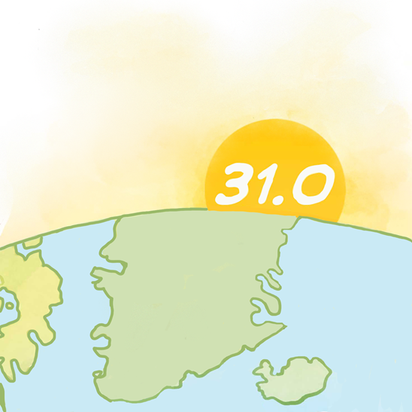
How to Submit a Score and Revision of Handicap Index
A player should submit their score as soon as possible on the day of play
This should be at the venue being played
Must be submitted hole by hole
The handicap index will then be updated overnight
Notes:
The Score should be submitted as soon as possible after play has been completed as the handicap calculation will take place after midnight.
This should ideally done by the player directly into the computer system
Scores must be submitted hole by hole, ensuring that holes not played are clearly marked
The handicap will be updated overnight and will be ready for the player the next day
If a score cannot be added for some reason it must be added to the players record as soon as possible, ensuring the PCC adjustment is applied for the round played
If more than one score is posted in a single day (e.g multi round competition) the Handicap Index would not normally be updated until the next day, so you wouldn’t update the index between the rounds.
The closing of a competition and the calculation of the handicap should not be confused. The score will be returned and recalculated regardless of whether the competition has been officially closed in terms of the result. So you won’t need to be returning to the club on a Saturday night to satisfy all the post competition admin if its not practical.
After you have submitted a score for a competition, the system will calculate your new index the following night and you will be able to access you new handicap the following morning ready to play again.
The closing of a competition and the calculation of the handicap should not be confused. The handicap will be return and recalculated regardless of whether the competition has been officially closed. So you won’t need to be returning to the club on a Saturday night to satisfy all the post competition admin if its not practical.
If you need to subsequently change scores or DQ scores from being qualifying then you can do so in the following days and the index will then be updated after that if needs be.

Slide 36
The Process
Handicap Index
Work out the Course Handicap
Adjust for the format/ competition
Play golf
Return score
Know it/Look it up
App .
Online.
Club.
Use the look up chart, or a course handicap calculator.
Check the allowance and apply it if needed.
Grip it and rip it.
Input the score as soon as possible into the computer.
Notes:
So to recap the process:
Know your handicap index, and where to find it
Establish your course handicap, know where or how to look it up
Adjust this for the format of golf you are playing
Play
Post your score asap.

Slide 37
MyGolf Profile
All Golfers will have a Wales Golf MyGolf profile
View your index
Track your scores
Keep up to date on latest news, information, programmes, promotions from Wales Golf and Wales Golf partners
Interact with fellow golfers.
Notes:
So thats what the club will get but what about the players.
All players at affiliated clubs will get access to a personal mygolf profile.

Slide 38
Wales Golf App
Handicap Index
Progression
Score details
Social networking
Interact with fellow golfers
Organise
Comment
Follow
Interaction with Wales Golf
Events
Opportunities
Future
Course Handicap Calculator
In built rules widget
Tee time booking
Score card

Slide 39
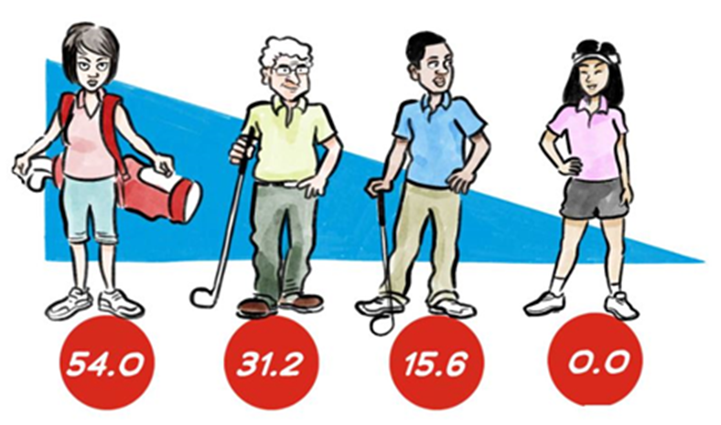
Transition
We hope that by October we will be in a position to start displaying the new handicap on the Wales Golf Platforms.
Players will then be in a position to start signing up to their profile and keeping an eye on their handicap
Nov 2 2020 you will then need to start playing your golf under the new WHS rules and using the procedures we’ve highlighted in this presentation.
Notes:
Once all handicaps are transitioned there will be a period where both records will run alongside one another. Probably for a month or so which will allow clubs and players to see how their handicaps will look at how their index will start to progress whilst still playing under their CONGU handicap.

Slide 40
Who Administrates your handicap?
Home Club.
National Union
R&A/USGA
Your Home Club and its handicap committee will be responsible for the day to day maintenance and administration of your handicap. Including carrying out reviews, applying penalties, assigning new handicaps and more.
Wales golf are responsible for the maintenance and upkeep of the central handicap calculator and database. We will ensure the handicap is calculated correctly and give the golfer direct access to your most up to date Handicap Index and scoring record.
Responsible for the Rules of Handicapping on a global scale.

Slide 41
Questions?
Please direct any further questions to your handicap committee or handicapping@walesgolf.org

